Slide 1

Manchester City Evolution 2000 - 2021

Slide 2
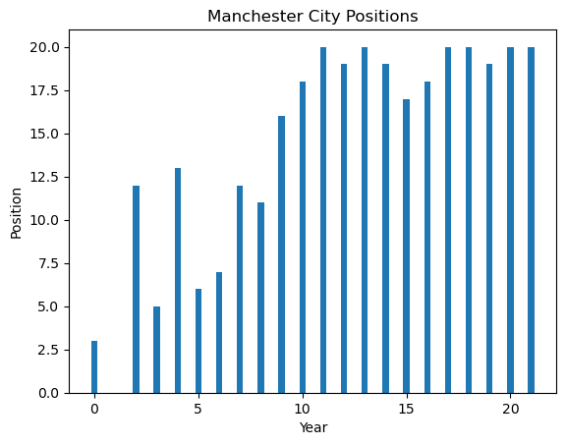
League Position
Means Position = 1
2008

Slide 3
import matplotlib.pyplot as plt
# Create some sample data
years = []
for i in range(22):
if i != 1:
years.append(i)
values = pdf.loc[pdf['Team'] == "Manchester City", 'Pos'].values
for i in range(len(values)):
values[i] = 21 - values[i]
# Plot the values against the years
plt.plot(years, values)
# Add labels and title to the plot
plt.xlabel('Year')
plt.ylabel('Position')
plt.title('ManCity Positions')
# Display the plot
plt.show()

Slide 4
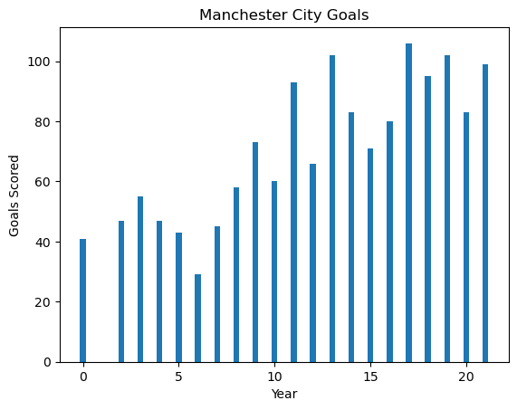
Goals Scored
Also in 2008

Slide 5
goals = pdf.loc[pdf['Team'] == "Manchester City", 'GF'].values
# Plot the values against the years
plt.plot(years, goals)
# Add labels and title to the plot
plt.xlabel('Year')
plt.ylabel('Goals For')
plt.title('')
# Display the plot
plt.show()

Slide 6
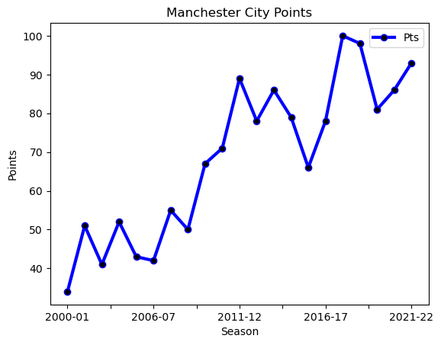
Points
2008 the magical year

Slide 7
man_city = pdf[pdf['Team'] == 'Manchester City']
man_city.plot(x='Season', y='Pos', marker = 'o', ms = '6', lw = '3', mfc = 'black', c = 'red')
plt.xlabel('Season')
plt.ylabel('Points')
plt.title("Manchester City Points")
plt.legend(['Pts']);
plt.gca().invert_yaxis()

Slide 8
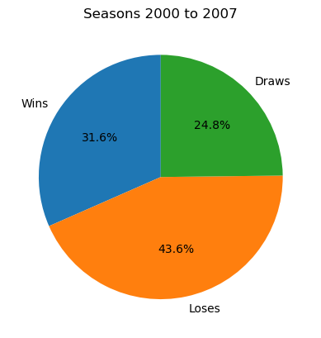
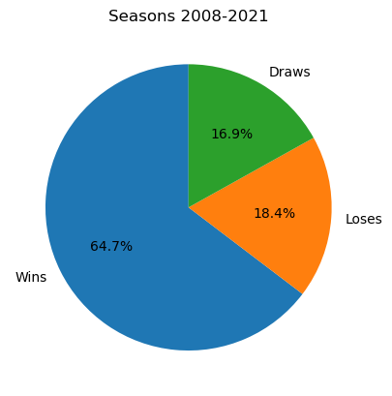
Can you see how does their wins increased
Wins, Loses, and Draws

Slide 9
d = pdf[(pdf['Season'].between('2008-09', '2021-22'))]
wins = d.loc[(d["Team"] == "Manchester City"), 'W'].sum()
loses = d.loc[(d["Team"] == "Manchester City"), 'L'].sum()
draws = d.loc[(d["Team"] == "Manchester City"), 'D'].sum()
values = [wins, loses, draws]
labels = ['Wins', 'Loses', 'Draws']
# Create the pie chart
fig, ax = plt.subplots()
ax.pie(values, labels=labels, autopct='%1.1f%%', startangle=90)
# Add a title to the chart
plt.title('Seasons 2008-2021')
# Display the chart
plt.show()
d = pdf[(pdf['Season'].between('2008-09', '2021-22'))]
wins = pdf.loc[(pdf["Team"] == "Manchester City"), 'W'].sum()
loses = pdf.loc[(pdf["Team"] == "Manchester City"), 'L'].sum()
draws = pdf.loc[(pdf["Team"] == "Manchester City"), 'D'].sum()
values = [wins, loses, draws]
labels = ['Wins', 'Loses', 'Draws']
# Create the pie chart
fig, ax = plt.subplots()
ax.pie(values, labels=labels, autopct='%1.1f%%', startangle=90)
# Add a title to the chart
plt.title('Wins, Loses, and Draws')
# Display the chart
plt.show()

Slide 10





But what happened in 2008 ??
Sheikh Mansour bin Zayed so no need for any explanations
Then in 2016, Pep became the coach

Slide 11
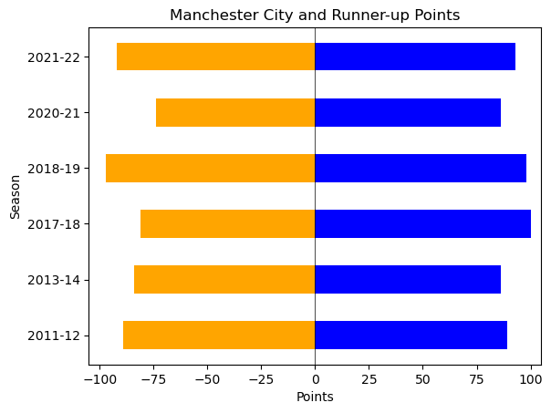
One can say that the league then wasn’t good, or the clubs weren’t good, see this graph first
which illustrates the points scored by Manchester City in a winning season and its runner-up
Competitiveness
And if you can’t see the very small margin of points between Manchester City
and its competitive in a specific season, have a look on the next slide

Slide 12
import matplotlib.pyplot as plt
import numpy as np
# Get the second rows for each season
second_rows = pdf.groupby("Season").nth(1)
# Get the rows where Manchester City is in position 1
city_pos1 = pdf[(pdf["Team"] == "Manchester City") & (pdf["Pos"] == 1)]
# Merge the second rows with the rows where Manchester City is in position 1
second_rows_pos1 = pd.merge(second_rows, city_pos1[["Season"]], on="Season", how="inner")
man_city = pdf.loc[(pdf['Team'] == "Manchester City") & (pdf['Pos'] == 1)]
man_city_pts = man_city["Pts"].values
#####################################################################################################
# Get the second rows for each season
second_rows = pdf.groupby("Season").nth(1)
# Get the rows where Manchester City is in position 1
city_pos1 = pdf[(pdf["Team"] == "Manchester City") & (pdf["Pos"] == 1)]
# Merge the second rows with the rows where Manchester City is in position 1
second_rows_pos1 = pd.merge(second_rows, city_pos1[["Season"]], on="Season", how="inner")
runner_up_pts = second_rows_pos1["Pts"].values
#####################################################################################################
colors = np.array(['blue', 'orange'])
fig, ax = plt.subplots()
bars1 = ax.barh(labels, man_city_pts, color=colors[0], height=0.5, align='center', label='Values 1')
bars2 = ax.barh(labels, -runner_up_pts, color=colors[1], height=0.5, align='center', label='Values 2')
ax.axvline(x=0, color='black', linewidth=0.5)
ax.set_xlim([-105, 105])
ax.set_xlabel('Points')
ax.set_ylabel('Season')
ax.set_title('Manchester City and Runner-up Points')
plt.show()

Slide 13
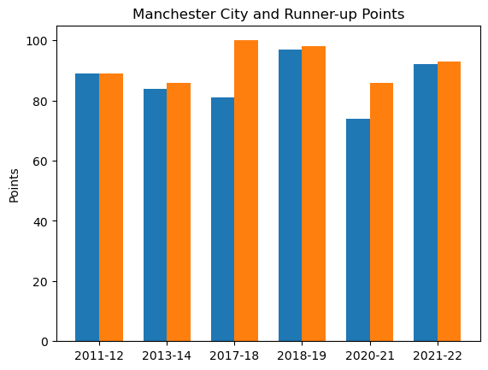
Competitiveness
Very close right,
well not in all seasons

Slide 14
width = 0.35
fig, ax = plt.subplots()
ax.bar(np.arange(len(manu_pts))-width/2, manu_pts, width, label='Manchester United')
ax.bar(np.arange(len(mancity_pts))+width/2, mancity_pts, width, label='Manchester City')
plt.title('Manchester City and Runner-up Points')
plt.xlabel('')
plt.ylabel('Points')
plt.xticks(np.arange(len(labels)), labels)
plt.show()

Slide 15
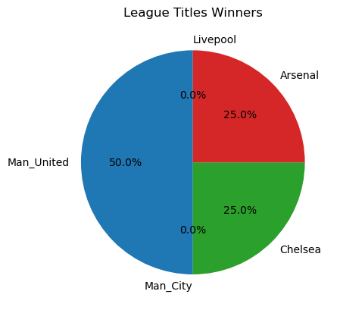
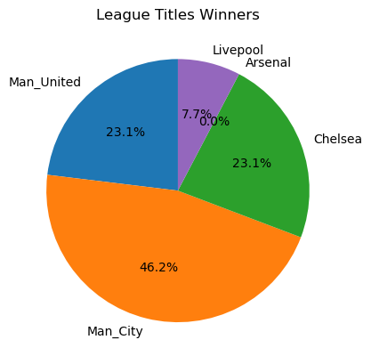
Now let’s look at the League titles before 2008 and after
Before
After
0 Leagues
6 Leagues
League Titles

Slide 16
import matplotlib.pyplot as plt
# Define the data
Man_Uited = pdf.loc[(pdf['Team'] == "Manchester United") & (pdf['Pos'] == 1) & (pdf['Season'].between('2000-01', '2007-08')), 'Pos'].count()
Man_City = pdf.loc[(pdf['Team'] == "Manchester City") & (pdf['Pos'] == 1) & (pdf['Season'].between('2000-01', '2007-08')), 'Pos'].count()
Chelsea = pdf.loc[(pdf['Team'] == "Chelsea") & (pdf['Pos'] == 1) & (pdf['Season'].between('2000-01', '2007-08')), 'Pos'].count()
Arsenal = pdf.loc[(pdf['Team'] == "Arsenal") & (pdf['Pos'] == 1) & (pdf['Season'].between('2000-01', '2007-08')), 'Pos'].count()
Livepool = pdf.loc[(pdf['Team'] == "Liverpool") & (pdf['Pos'] == 1) & (pdf['Season'].between('2000-01', '2007-08')), 'Pos'].count()
values = [Man_Uited, Man_City, Chelsea, Arsenal, Livepool]
labels = ['Man_United', 'Man_City', 'Chelsea', 'Arsenal', 'Livepool']
# Create the pie chart
fig, ax = plt.subplots()
ax.pie(values, labels=labels, autopct='%1.1f%%', startangle=90)
# Add a title to the chart
plt.title('League Titles Winners')
# Display the chart
plt.show()

Slide 17
# Define the data
Man_Uited = pdf.loc[(pdf['Team'] == "Manchester United") & (pdf['Pos'] == 1) & (pdf['Season'].between('2008-09', '2021-22')), 'Pos'].count()
Man_City = pdf.loc[(pdf['Team'] == "Manchester City") & (pdf['Pos'] == 1) & (pdf['Season'].between('2008-09', '2021-22')), 'Pos'].count()
Chelsea = pdf.loc[(pdf['Team'] == "Chelsea") & (pdf['Pos'] == 1) & (pdf['Season'].between('2008-09', '2021-22')), 'Pos'].count()
Arsenal = pdf.loc[(pdf['Team'] == "Arsenal") & (pdf['Pos'] == 1) & (pdf['Season'].between('2008-09', '2021-22')), 'Pos'].count()
Livepool = pdf.loc[(pdf['Team'] == "Liverpool") & (pdf['Pos'] == 1) & (pdf['Season'].between('2008-09', '2021-22')), 'Pos'].count()
values = [Man_Uited, Man_City, Chelsea, Arsenal, Livepool]
labels = ['Man_United', 'Man_City', 'Chelsea', 'Arsenal', 'Livepool']
# Create the pie chart
fig, ax = plt.subplots()
ax.pie(values, labels=labels, autopct='%1.1f%%', startangle=90)
# Add a title to the chart
plt.title('League Titles Winners')
# Display the chart
plt.show()

Slide 18
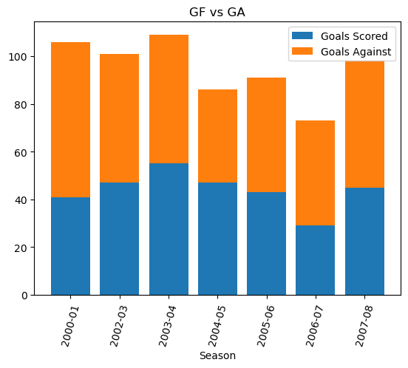
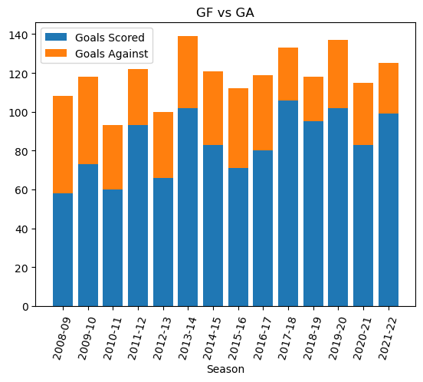
Pre 2008
Post 2008
Goals Scored vs Goals Against

Slide 19
# Get the rows where Manchester City is in position 1
man_city = pdf[(pdf["Team"] == "Manchester City") & (pdf['Season'].between('2000-01', '2007-08'))]
fig, ax = plt.subplots()
# plot the bars for each metric
ax.bar(man_city['Season'], man_city['GF'], label='Goals Scored')
ax.bar(man_city['Season'], man_city['GA'], bottom=man_city['GF'], label='Goals Against')
#ax.bar(man_city['Season'], man_city['GD'], bottom=man_city['GF'] + man_city['GA'], label='Goals Difference')
plt.xticks(rotation=75)
# set labels and title
ax.set_xlabel('Season')
ax.set_ylabel('')
ax.set_title('GF vs GA')
# add legend
ax.legend()
plt.show()
# Get the rows where Manchester City is in position 1
man_city = pdf[(pdf["Team"] == "Manchester City") & (pdf['Season'].between('2008-09', '2021-22'))]
fig, ax = plt.subplots()
# plot the bars for each metric
ax.bar(man_city['Season'], man_city['GF'], label='Goals Scored')
ax.bar(man_city['Season'], man_city['GA'], bottom=man_city['GF'], label='Goals Against')
#ax.bar(man_city['Season'], man_city['GD'], bottom=man_city['GF'] + man_city['GA'], label='Goals Difference')
plt.xticks(rotation=75)
# set labels and title
ax.set_xlabel('Season')
ax.set_ylabel('')
ax.set_title('GF vs GA')
# add legend
ax.legend()
plt.show()

Slide 20
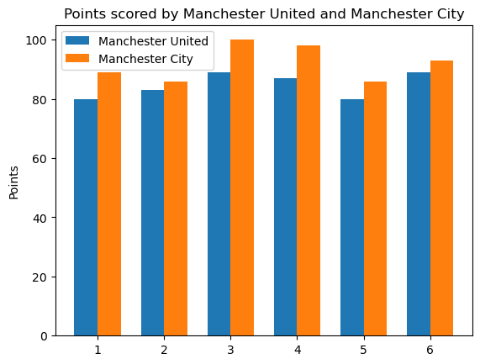
Let’s now compare Manchester City’s numbers,
and one of the best clubs in England numbers
Manchester City Vs Manchester United
(Points Scored by each in their winning seasons)
Manchester City wins

Slide 21
import matplotlib.pyplot as plt
import numpy as np
# Assume manu_pts and mancity_pts are the arrays containing the points scored
# by Manchester United and Manchester City respectively
manu_pts = pdf.loc[(pdf['Team'] == 'Manchester United') & (pdf['Pos'] == 1), 'Pts'].values
mancity_pts = pdf.loc[(pdf['Team'] == 'Manchester City') & (pdf['Pos'] == 1), 'Pts'].values
labels = ['1', '2', '3', '4', '5', '6']
width = 0.35
fig, ax = plt.subplots()
ax.bar(np.arange(len(manu_pts))-width/2, manu_pts, width, label='Manchester United')
ax.bar(np.arange(len(mancity_pts))+width/2, mancity_pts, width, label='Manchester City')
plt.title('Points scored by Manchester United and Manchester City')
plt.xlabel('Position')
plt.ylabel('Points')
plt.xticks(np.arange(len(labels)), labels)
plt.legend()
plt.show()

Slide 22
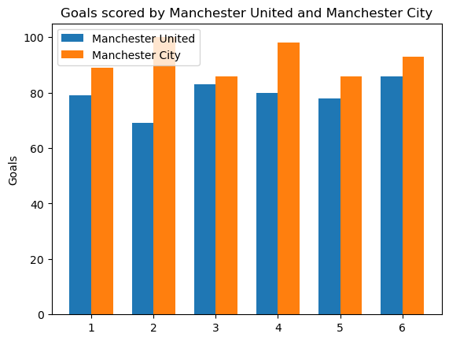
Manchester City Vs Manchester United
(Goals Scored)
No doubt

Slide 23
manu_pts = United_pts = pdf.loc[(pdf['Team'] == 'Manchester United') & (pdf['Pos'] == 1), 'GF'].values
mancity_pts = pdf.loc[(pdf['Team'] == 'Manchester City') & (pdf['Pos'] == 1), 'GF'].values
labels = ['1', '2', '3', '4', '5', '6']
width = 0.35
fig, ax = plt.subplots()
ax.bar(np.arange(len(manu_pts))-width/2, manu_pts, width, label='Manchester United')
ax.bar(np.arange(len(mancity_pts))+width/2, mancity_pts, width, label='Manchester City')
plt.title('Points scored by Manchester United and Manchester City')
plt.xlabel('Position')
plt.ylabel('Points')
plt.xticks(np.arange(len(labels)), labels)
plt.legend()
plt.show()

Slide 24
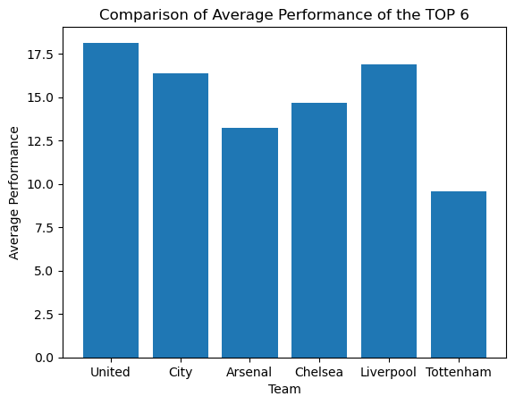
Now let’s see the overall average Performance
of the Top 6
Average Overall Performance
There is no doubt that Manchester City is becoming
one of the best clubs in England, it’s just a matter of
time to be the best

Slide 25
man_utd_df = pdf[pdf['Team'] == 'Manchester United']
man_utd_df = man_utd_df['Pos'].values
man_cty_df = pdf[pdf['Team'] == 'Manchester City']
man_cty_df = man_cty_df['Pos'].values
man_cty_df = np.append(man_cty_df, 20)
arsenal = pdf[pdf['Team'] == 'Arsenal']
arsenal = arsenal['Pos'].values
chelsea = pdf[pdf['Team'] == 'Chelsea']
chelsea = chelsea['Pos'].values
liverpool = pdf[pdf['Team'] == 'Liverpool']
liverpool = liverpool['Pos'].values
tot = pdf[pdf['Team'] == 'Tottenham Hotspur']
tot = tot['Pos'].values
for i in range(len(pos_values)):
man_utd_df[i] = 21 - man_utd_df[i]
man_cty_df[i] = 21 - man_cty_df[i]
arsenal[i] = 21 - arsenal[i]
chelsea[i] = 21 - chelsea[i]
liverpool[i] = 21 - liverpool[i]
tot[i] = 21 - tot[i]
x = ['United', 'City', 'Arsenal' , 'Chelsea' , 'Liverpool', 'Tottenham']
y = [np.mean(man_utd_df), np.mean(man_cty_df), np.mean(arsenal), np.mean(chelsea), np.mean(liverpool), np.mean(tot)]
fig, ax = plt.subplots()
ax.bar(x, y)
ax.set_xlabel('Team')
ax.set_ylabel('Average Performance')
ax.set_title('Comparison of Average Performance of the TOP 6')
# show the plot
plt.show()

